Slide 1


Three.js Workshop: A Beginner's Guide
Dive into the world of Three.js, a powerful JavaScript library that enables the creation of stunning 3D graphics and interactive web experiences. This workshop will guide you through the fundamental concepts and step-by-step implementation of Three.js projects.
Notes:
1

Slide 2

What is Three.js?
1
Powerful 3D Rendering
2
Cross-Browser Compatibility
3
Open-Source and Flexible
Three.js is a JavaScript library that simplifies the creation of 3D graphics and animations on the web.
It provides a consistent 3D experience across various web browsers, making it a versatile choice.
Three.js is an open-source project, offering a vast ecosystem of resources and community support.
Notes:
2

Slide 3

Getting Started with Three.js
Set Up the Environment
1
Install Node.js and set up a development environment with a code editor and a local server.
Import Three.js
2
Add the Three.js library to your project using a CDN or by installing it via npm.
Learn the Basics
3
Familiarize yourself with the core concepts of Three.js, such as scenes, cameras, and renderers.
Notes:
3

Slide 4
Creating a Scene
Scene Setup
Rendering the Scene
Responsive Design
Create a Three.js scene and add it to the DOM. Customize the background color and camera settings.
Set up a render loop to continuously update the scene and display it in the browser.
Ensure your 3D scene adapts to different screen sizes and aspect ratios.
Notes:
4

Slide 5

Adding Geometry and Lighting
Geometric Primitives
1
Use Three.js's built-in geometric shapes, such as cubes, spheres, and planes, to create 3D objects.
Custom Geometries
2
Define custom 3D geometries by manipulating vertices, faces, and other geometric properties.
Lighting the Scene
3
Add ambient, directional, and point lights to your scene to create depth and atmosphere.
Notes:
5

Slide 6
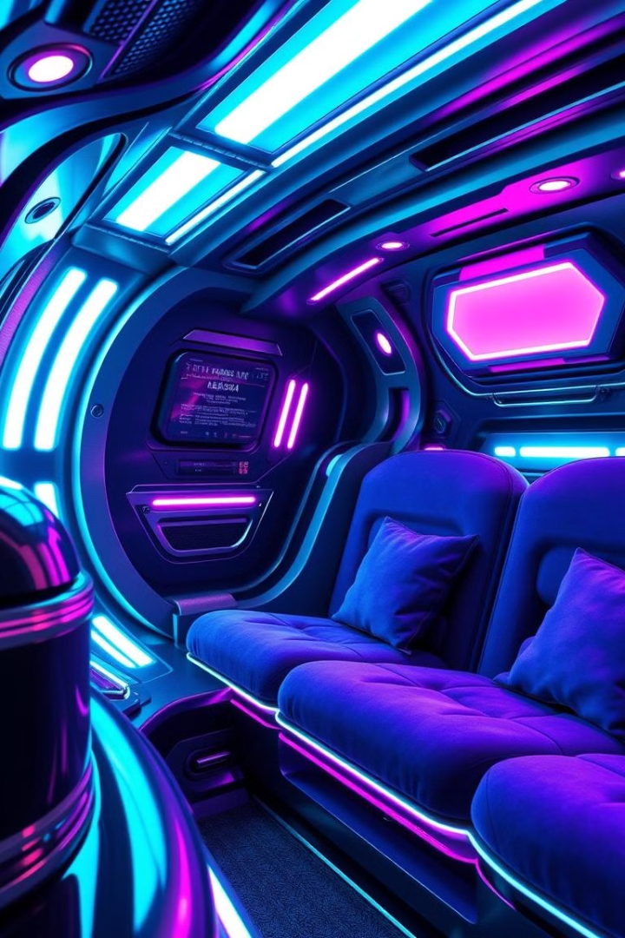
Applying Materials and Textures
Material Properties
Texture Mapping
Customize the appearance of objects by adjusting material properties such as color, shininess, and transparency.
Apply 2D images as textures to your 3D objects, creating realistic surfaces and patterns.
Advanced Materials
Explore more complex material types, like PBR (Physically-Based Rendering) materials, for even greater realism.
Notes:
6

Slide 7




Interactions and Events
Mouse Input
Handle mouse events, such as clicks and hovers, to enable interactivity in your 3D scene.
Keyboard Input
Respond to keyboard events to allow users to control and interact with your 3D environment.
Touch Interactions
Adapt your 3D scene to work seamlessly on touch-enabled devices, enabling mobile interactivity.
Notes:
7

Slide 8




Animations and Transformations
Object Transformations
Move, rotate, and scale 3D objects to create dynamic and engaging scenes.
Animation Techniques
Utilize Three.js's animation system to bring your 3D objects and scenes to life.
Timed Animations
Synchronize object movements and camera changes to create smooth, choreographed animations.
Notes:
8

Slide 9

Real-world Examples and Best Practices
Immersive Experiences
Interactive Prototypes
Showcase creative use of Three.js for building virtual tours, architectural visualizations, and interactive art installations.
Demonstrate the use of Three.js in building interactive product demos, UI prototypes, and interactive web pages.
Notes:
9

